Slide 1
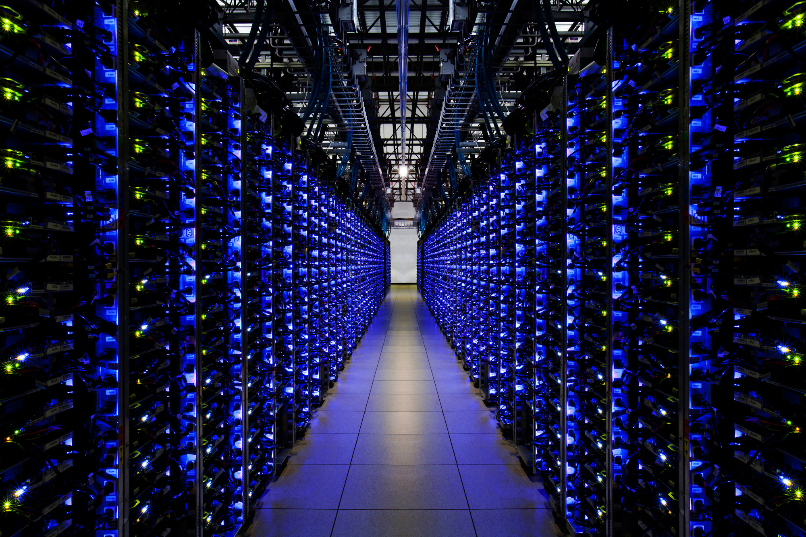
BNVirt: Bare Metal Network Virtualization
Notes:
Hi All, I am going to talk about my work “bare metal network virtualization” which is a virtualization technique for the networks to provide programmable networks (SDN) to the tenants sharing the same underlying hardware

Slide 2

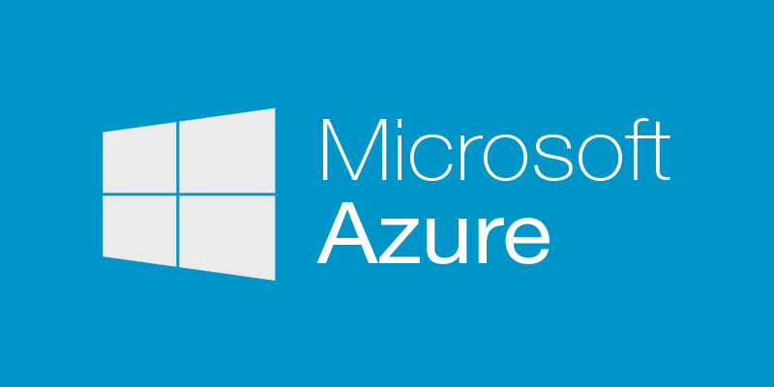











Notes:
There are innumerable cloud services like amazon, azure which provide compute platform/hosting services for companies (customers), researchers, etc.
This industry is still growing with latest technological changes.

Slide 3
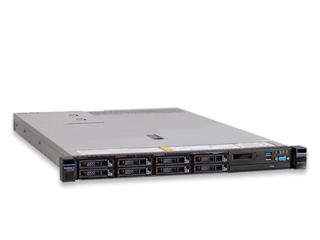




Virtual Machines vs Bare Metal
VM7
VM6
VM5
VM4
VM3
VM2
VM1
Vmware or QEMU
“Worldwide Bare Metal Cloud Market to Grow at a CAGR of 43.2% during 2016-2022 to aggregate $9150.3 million by 2022”. – Research & Markets
Notes:
The platform provided to the customers may be hosted as VMs.
Alternatively, they also provide bare metal servers whch can be used completely by the clients. This is getting more popular coz of high computing apps :
1)bigdata, deeplearning,
2) Increase in interest towards containers (docker), which are light weight vms.
3) Privacy concerns, (companies do not want their vms to co-locate with other other companies vms)

Slide 4
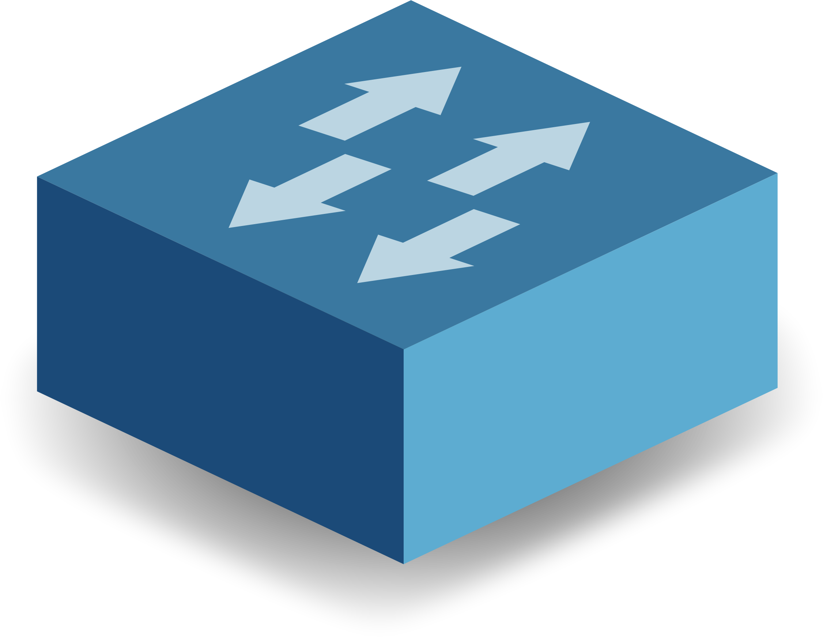
Network Virtualization
Virtual Network 1
Virtual Network 2
Virtual Network 3
Virtualization Layer
VLAN
L2VPN
VxLAN
Hypervisors (SDN)
Physical Network
Notes:
Network virtualization has been around for a long time, in the name of VLANs, which can be used to create separate L2 network.
L2VPN, for
VXLANs create overlay network using encapsulation
However, all three provide virtualization at data-plane ,
In order to provide virtualization at control-plane, we need SDN hypervisors.
But, first let me give an example of a work which uses VXLANS

Slide 5
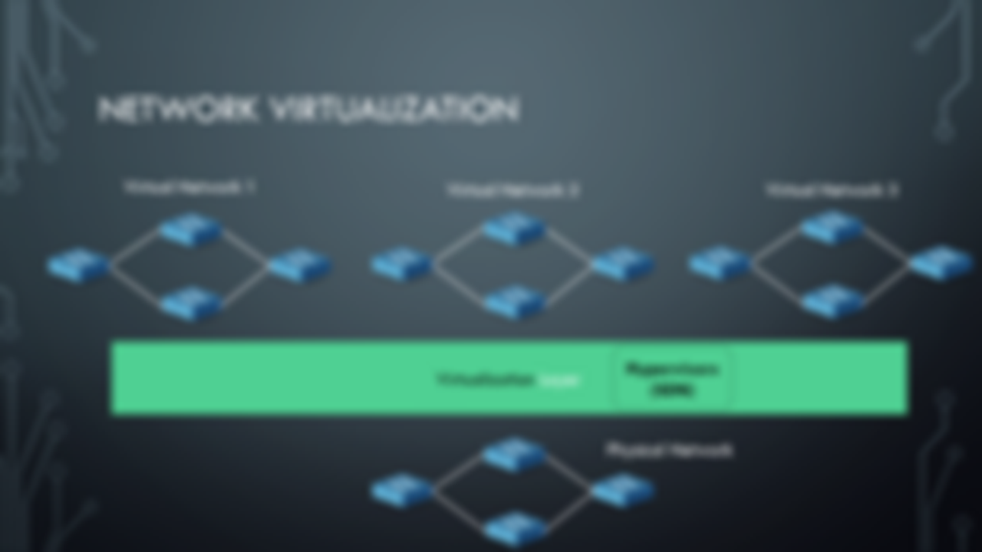
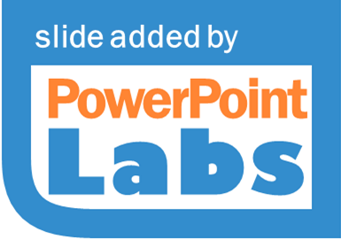
VLAN
L2VPN
VxLAN

Slide 6
Network Virtualization (Overlays/VXLANs)
VMs
VMs
VMs
VMs
OVS (Vmware)
OVS (Vmware)
OVS (VMware)
OVS (VMware)
VxLAN Encapsulation
Implement Load-Balancing schemes at the core,
Difficult to support Bare-metal provisioning.
2) Cannot support various topologies for tenants
Network Virtualization in Multi-tenant Datacenters, NSDI 2014
Notes:
This is the network virtualization platform, by Vmware, which is quite standard and being used by most cloud services (OpenStack)
Basicaly, the hosts are VMs, and control plane virtualization is done using OVS (software switches) at network hypervisor.
Data plane virtualization is done using Vxlan. Hence the core network is completely independent of the control plane.
Hence, core may not be able to provide performance guarantees
One possible solution to implement topologies is by using servers to hosts software switches (controlled) . However, we can see why its not feasible in the next few slides.

Slide 7
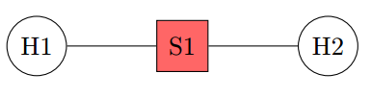
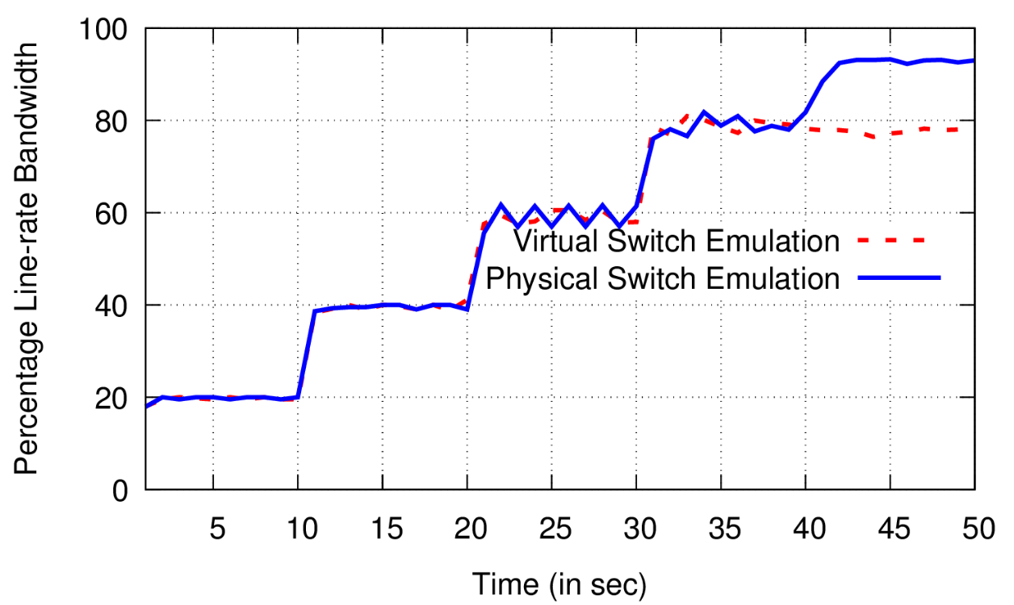
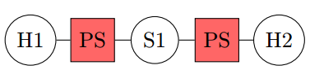
Virtual Switch Emulation
Measuring Throughput
Virtual Topology
Physical Topology

Slide 8
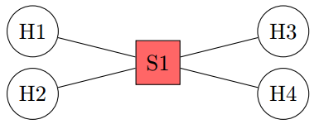
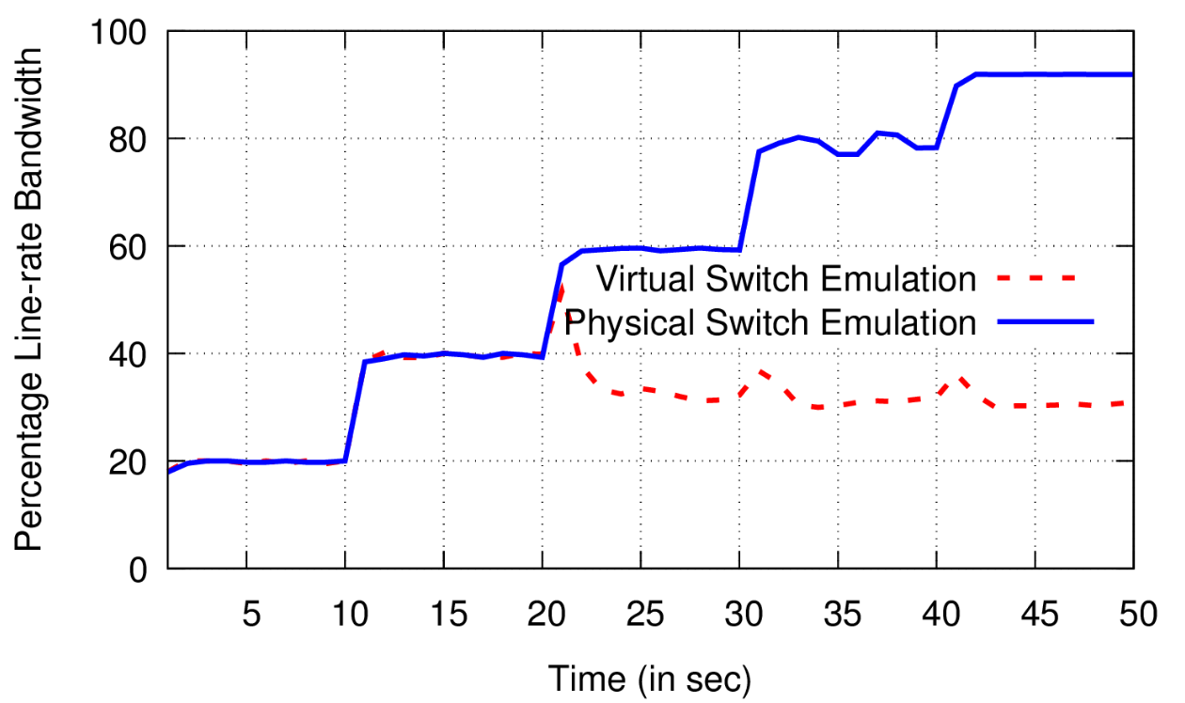
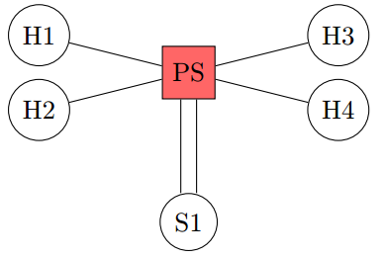
Virtual Switch Emulation
Measuring Throughput

Slide 9
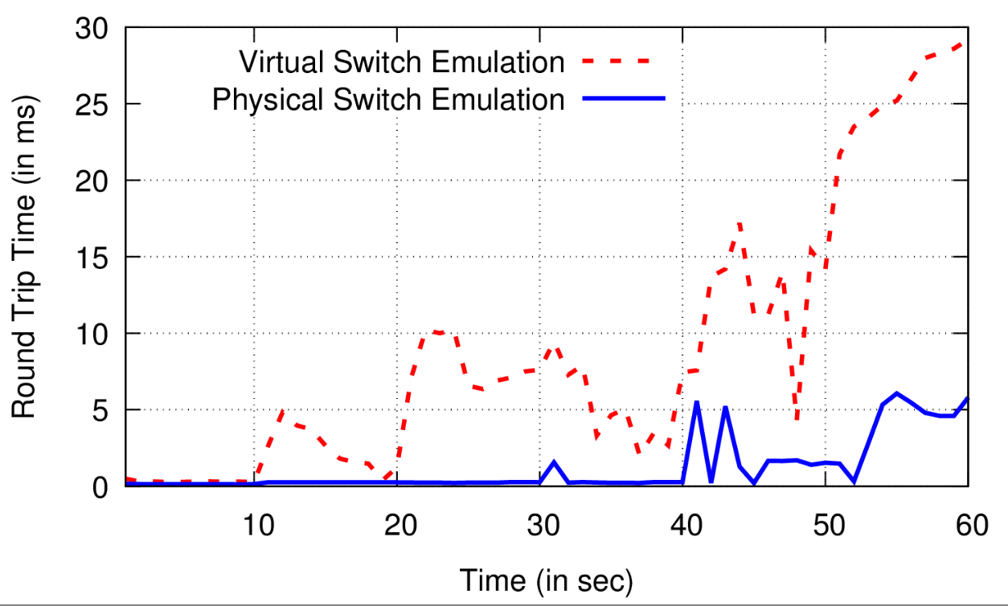
Virtual Switch Emulation
Measuring RTT Variance
Virtual Topology
Physical Topology

Slide 10
Network Virtualization
Virtual Network 1
Virtual Network 2
Virtual Network 3
Virtualization Layer
VLAN
L2VPN
VxLAN
Hypervisors (SDN)
Physical Network

Slide 11
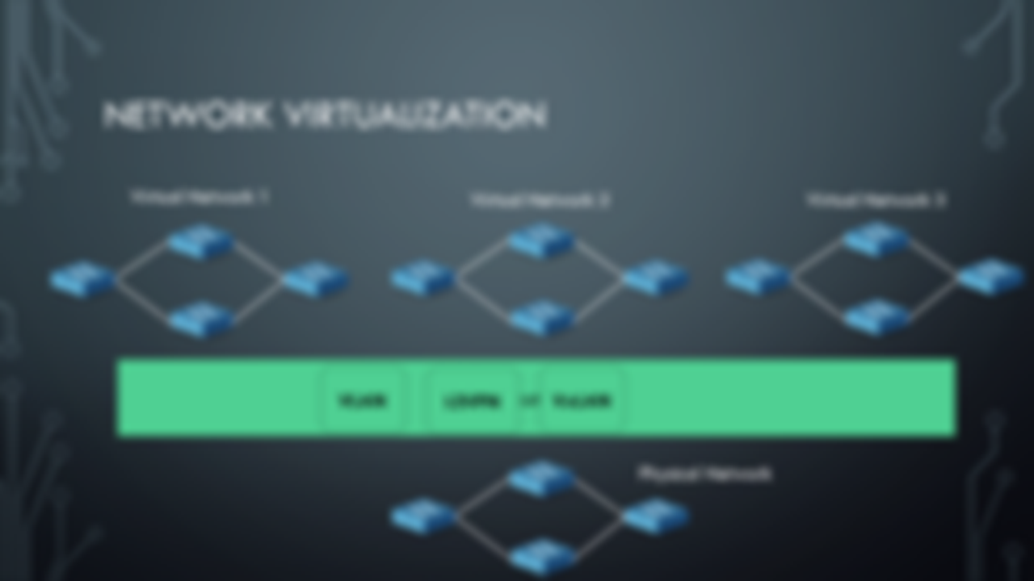
Hypervisors (SDN)

Slide 12
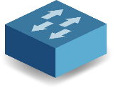

Supports only limited network topologies
Tenant 1
Tenant 2
Tenant 3
OpenDaylight Controller
ONOS Controller
POX Controller
OpenFlow
Existing Network Hypervisors (FlowVisor, OpenVirtex)
OpenFlow
Switch1
Switch2

Slide 13
Challenges – Summary
Supporting Arbitrary Topologies.
Providing Latency/ Bandwidth Guarantees.
Isolation from other tenants.

Slide 14
Tenant 1 (DC)
Tenant 2 (Internet)
Tenant 3 (SDN WAN)
POX Controller
OpenDaylight Controller
ONOS Controller
OpenFlow
Bare-metal Topology Abstraction using existing physical infrastructure
OpenFlow
Switch1
Switch2

Slide 15

Tenant 1 (DC)
Tenant 2 (ISP)
Tenant 3 (SDN WAN)
POX Controller
OpenDaylight Controller
ONOS Controller
OpenFlow
Virtual Topology
BNVirt
Switch Abstraction
Network Embedder
Tenant Mapping
Flow Translation
OpenFlow
Switch1
Switch2

Slide 16
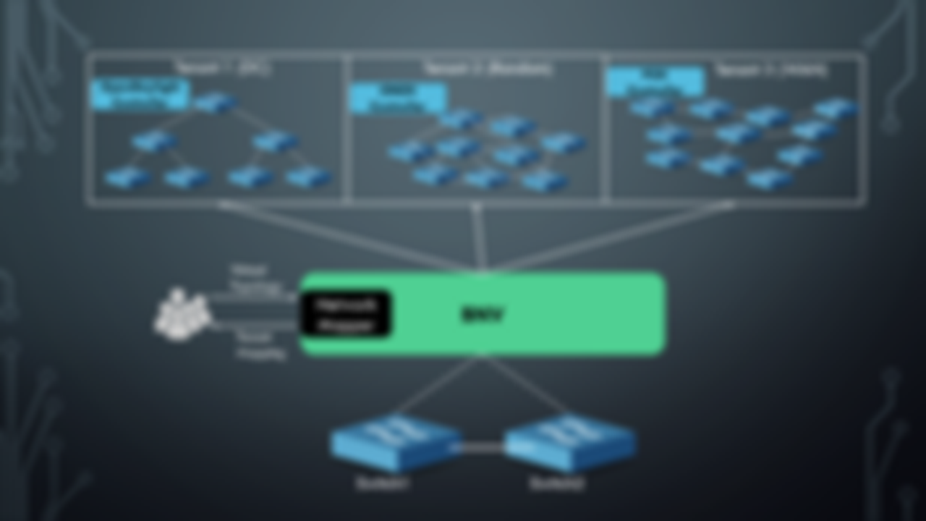
Switch Abstraction
Flow Translation

Slide 17
GENERIC Topology
pSwitch1
CLink1
pSwitch2
5
5
1
2
3
4
1
2
3
4
H1
H2
H3
H4
H5
H6
H7
H8

Slide 18
H1
vS1
vS3
H5
1
2
3
2
1
3
vS2
2
1
3
H2
Virtual Topology
Physical Topology
pSwitch1
CLink1
pSwitch2
5
5
1
2
3
4
1
2
3
4
H1
H2
H3
H4
H5
H6
H7
H8

Slide 19
H1
vS1
vS3
H5
1
2
3
2
1
3
vS2
2
1
3
H2
Virtual Topology
Physical Topology
pSwitch1
CLink1
pSwitch2
5
5
1
2
3
4
1
2
3
4
H1
H2
H3
H4
H5
H6
H7
H8

Slide 20
H1
vS1
vS3
H5
1
2
3
2
1
3
vS2
2
1
3
H2
Virtual Topology
Physical Topology
pSwitch1
CLink1
pSwitch2
5
5
1
2
3
4
1
2
3
4
H1
H2
H3
H4
H5
H6
H7
H8

Slide 21
H1
vS1
vS3
H5
1
2
3
2
1
3
vS2
2
1
3
H2
Virtual Topology
Physical Topology
pSwitch1
CLink1
pSwitch2
5
5
1
2
3
4
1
2
3
4
H1
H2
H3
H4
H5
H6
H7
H8

Slide 22
H1
vS1
CLink1
vS3
H5
1
2
3
2
1
3
vS2
2
1
3
H2
Virtual Topology
Physical Topology
pSwitch1
5
CLink1
pSwitch2
5
1
2
3
4
1
2
3
4
H1
H2
H3
H4
H5
H6
H7
H8

Slide 23
H1
vS1
CLink1
vS3
H5
1
2
3
2
1
3
CLink1
vS2
2
1
3
H2
Virtual Topology
Physical Topology
pSwitch1
5
CLink1
pSwitch2
5
1
2
3
4
1
2
3
4
H1
H2
H3
H4
H5
H6
H7
H8

Slide 24
H1
vS1
Link1
vS3
H5
1
2
3
2
1
3
Link3
Link2
vS2
2
1
3
H2
Virtual Topology
Physical Topology
pSwitch1
5
CLink1
pSwitch2
5
5
5
1
2
3
4
1
2
3
4
H1
H2
H3
H4
H5
H6
H7
H8

Slide 25
Final Mapping
H1
vS1
CLink1
vS3
H5
1
2
3
2
1
3
CLink1
CLink1
vS2
2
1
3
H2
Virtual Topology
Physical Topology
pSwitch1
CLink1
pSwitch2
5
5
1
2
3
4
1
2
3
4
H1
H2
H3
H4
H5
H6
H7
H8

Slide 26
Link 1 using Packet Tagging
PKT
H1
vS1
Link 1 : Tag 1
vS3
H5
1
2
3
2
1
3
Tag 3
Tag 2
vS2
2
1
3
H2
Virtual Topology
Physical Topology
pSwitch1
PKT
1
PKT
pSwitch2
5
CLink1
5
1
2
3
4
1
2
3
4
PKT
H1
H2
H3
H4
H5
H6
H7
H8

Slide 27
Link 2
H1
vS1
Link 1: Tag 1
vS3
H5
1
2
3
2
1
3
PKT
Tag 3
Link 2: Tag 2
vS2
2
1
3
H2
Virtual Topology
Physical Topology
pSwitch1
PKT
CLink1
PKT
2
pSwitch2
5
5
1
2
3
4
1
2
3
4
H1
H2
H3
H4
PKT
H5
H6
H7
H8

Slide 28
Link3 :
Bounce back Link
H1
vS1
Link 1 : Tag 1
vS3
H5
1
2
3
2
1
3
Switch | Rule
vS2 | In_port:1,ip dest:y.y.y.y,actions=output:2
vS1 | In_port:2,ip dest:y.y.y.y,actions=output:1
Link 3: Tag 3
Link 2: Tag 2
vS2
2
1
3
H2
Virtual Topology
PKT
Switch | Rule
vS2 | pSwitch1 : {in_port=1,ip dest:y.y.y.y,actions= LTag:2,output:5}
vL2 | pSwitch2 : {in_port=5,ip dest:y.y.y.y,LTag:2, actions=output:ingress}
vS1 | pSwitch1 : {in_port=5,ip dest:y.y.y.y,LTag:2, actions=RemoveLTag,output:2}
Physical Topology
PKT
3
pSwitch1
PKT
CLink1
pSwitch2
5
5
1
2
3
4
1
2
3
4
H1
H2
H3
H4
H5
H6
H7
H8
PKT

Slide 29
Topology + Loopback link
pSwitch1
CLink1
pSwitch2
5
5
1
2
3
4
1
2
3
4
H1
H2
LoopLink1
H5
H6
LoopLink2

Slide 30
H1
vS1
CLink1
vS3
H5
1
2
3
2
1
3
vS2
2
1
3
H2
Virtual Topology
Physical Topology
pSwitch1
CLink1
pSwitch2
5
5
1
2
3
4
1
2
3
4
H1
H2
LoopLink1
H5
H6
LoopLink2

Slide 31
H1
vS1
CLink1
vS3
H5
1
2
3
2
1
3
CLink1
vS2
2
1
3
H2
Virtual Topology
Physical Topology
pSwitch1
5
CLink1
pSwitch2
5
1
2
3
4
1
2
3
4
H1
H2
LoopLink1
H5
H6
LoopLink2

Slide 32
H1
vS1
CLink1
vS3
H5
1
2
3
2
1
3
LoopLink1
CLink1
vS2
2
1
3
H2
Virtual Topology
Physical Topology
pSwitch1
5
CLink1
pSwitch2
5
1
2
3
4
1
2
3
4
H1
H2
LoopLink1
H5
H6
LoopLink2

Slide 33
Link3 :
Loop Link
H1
vS1
Link 1 : Tag 1
vS3
H5
1
2
3
2
1
3
Link 2: Tag 2
Link 3: Tag 3
No Traffic Overhead in Core Link.
vS2
2) Consistency & Fidelity of mapping.
2
3
3) Complete traffic isolation.
1
H2
Virtual Topology
PKT
Physical Topology
pSwitch1
CLink1
pSwitch2
5
5
1
2
3
4
1
2
3
4
H1
H2
LoopLink1
H5
H6
LoopLink2
PKT

Slide 34
Link3 :
Loop Link
H1
vS1
Link 1 : Tag 1
vS3
H5
1
2
3
2
1
3
Switch | Rule
vS2 | In_port:1,ip dest:y.y.y.y,actions=output:2
vS1 | In_port:2,ip dest:y.y.y.y,actions=output:1
Link 3: Tag 3
Link 2: Tag 2
No Traffic Overhead in Core Link.
vS2
2) Consistency & Fidelity of mapping.
2
3
3) Complete traffic isolation.
1
H2
Virtual Topology
PKT
Switch | Rule
vS2 | pSwitch1 : {in_port=1,ip dest:y.y.y.y,actions=output:3}
vS1 | pSwitch1 : {in_port=4,ip dest:y.y.y.y,LTag:2, actions=output:2}
Physical Topology
pSwitch1
CLink1
pSwitch2
5
5
1
2
3
4
1
2
3
4
H1
H2
LoopLink1
H5
H6
LoopLink2

Slide 35
Core

Slide 36
Tenant 1 (DC)
Tenant 2 (Random)
Tenant 3 (WAN)
Virtual Topology
BNV
Switch Abstraction
Network Mapper
Tenant Mapping
Flow Translation
Switch1
Switch2

Slide 37
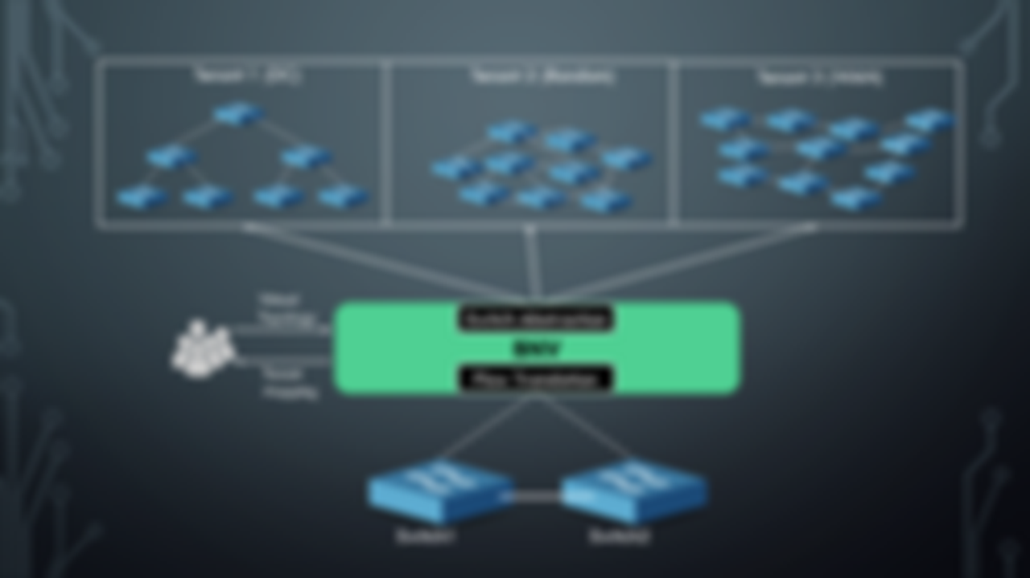
Network Mapper

Slide 38
Network Mapper
Core
Request
Network Mapper
Mapping

Slide 39
Network Mapper
Core
Request
1
1
Network Mapper
1
1
1
1
Mapping

Slide 40
Network Mapper
Core
C=x7
Request
1
1
Network Mapper
C=x5
C=y1
C=y2
C=x6
1
1
1
1
Mapping
C=x1
C=x2
C=x3
C=x4

Slide 41


Network Mapper – Key Ideas
1) Network mapping is done considering mapping of switch-ports instead of switches.
H1
H2
H3
H4
Switch
Switch
1
2
3
4
S1
S2
S3
S4
$$X_{ρ,q}=\left\{\begin{aligned}1 ;if ρ is placed in q \\ 0 ;otherwise \end{aligned}\right.$$
Switch-ports :
$$Y_{ρ,q}=\left\{\begin{aligned}1 ;if ρ is placed in q \\ 0 ;otherwise \end{aligned}\right.$$
Hosts :

Slide 42

Network Mapper – Key Ideas
2) Objective is to Minimize the usage of Core-links:
a) Maximizes isolation to the tenant, keeping links dedicated.
b) Provides scope for dynamic expansions. (Adding/upgrading tenants)
$$min : \sum_{\left\{q1,q2\right\}∈T}{\sum_{\{e1,e2\}∈Lc}{Xe1,q1 . Xe2,q2 . b(e1,e2)}}$$

Slide 43



Network Mapper – Constraints
$$∀i∈P: \sum_{j ∈Q}{Xi,j=1}$$
1) Switch one-to-one mapping:
$$∀i∈V: \sum_{j ∈H}{Yi,j=1}$$
2) Host one-to-one mapping:
$$∀\{i,j\}∈Lc: \sum_{\left\{k,h\right\}∈Kc}{Xi,k.Xj,h=1}$$
3) Link one-to-one mapping:

Slide 44
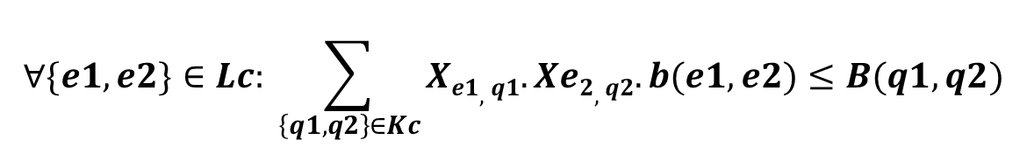


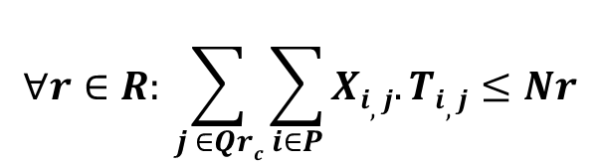
Network Mapper – Constraints
$$∀\left\{i,j\right\}∈Lh: \sum_{j ∈H}{Xi,q1. Xj,h1. δ(q1,h1)=1}$$
4) Switch-Host connectivity constraint:
$${δ(q1,h1)}_{}=\left\{\begin{aligned} 1 ;\text{if} \text{host} \text{h}\text{1 }\text{is} \text{connected} \text{to} \text{switch}\text{−}\text{port} \text{q}\text{1} \\ 0 ;otherwise \end{aligned}\right.$$
$$∀\{e1,e2\}∈Lc: \sum_{\left\{q1,q2\right\}∈Kc}{Xe1,q1.Xe2,q2.b(e1,e2)≤B(q1,q2)}$$
5) Link Bandwidth constraint:
$$∀r∈R: \sum_{j ∈Qrc}{\sum_{i∈P}{Xi,j.Ti,j≤Nr}}$$
6) TCAM capacity constraint:

Slide 45
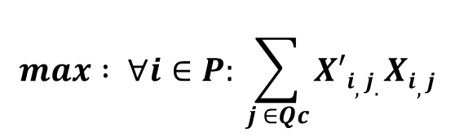
Network Mapper – Updates
Spec update of an existing tenant :
Minimize impact to other/current tenant(s)
$$max : ∀i∈P: \sum_{j ∈Qc}{X′i,j.Xi,j}$$

Slide 46



Implementation
Implemented on top of
Integrated with a Bare-metal provisioning service (Testbed).
Deployed on Production environment
Details :
Support OpenFlow 1.0, TODO: Upgrade to OpenFlow 1.3
Gurobi Solver for ILP.

Slide 47
evaluation
Testbed Experiments
Simulation of Network Mapper

Slide 48
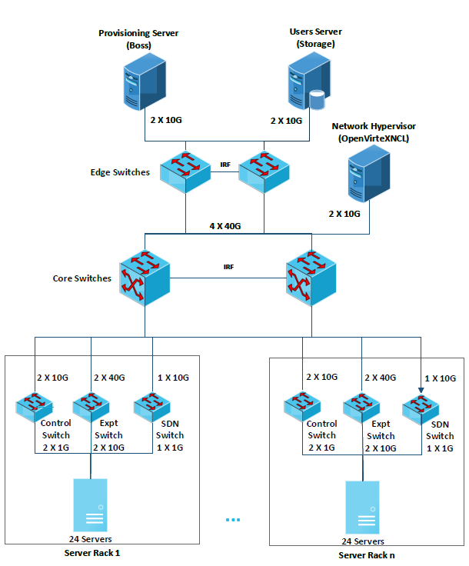
evaluation – Testbed Experiments

Slide 49
Topologies Emulated
Fat Tree 4
Standard Clos topologies
Hyper-X
Mesh
Ring
HyperCube

Slide 50
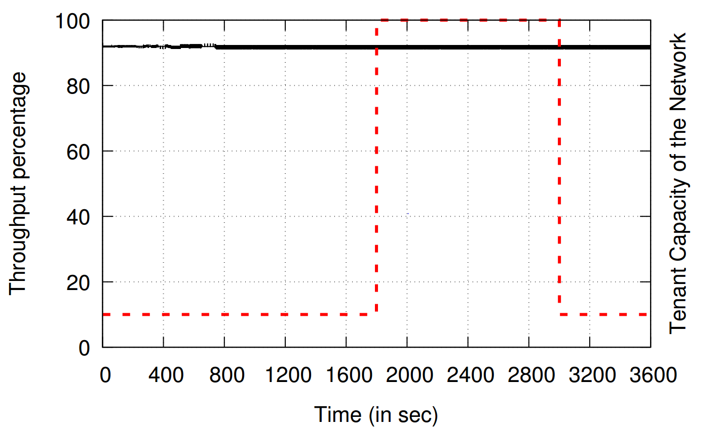
evaluation – Testbed Experiments
All Tenants
1 Tenant

Slide 51
Evaluation- Simulation of Network Mapper
Core L2 Switch
SDN
Switch1
SDN
Switch2
SDN
Switch3
SDN
Switch4
SDN
Switch5
12
Loops
12
Loops
12
Loops
12
Loops
12
Loops
24
Servers
24
Servers
24
Servers
24
Servers
24
Servers

Slide 52
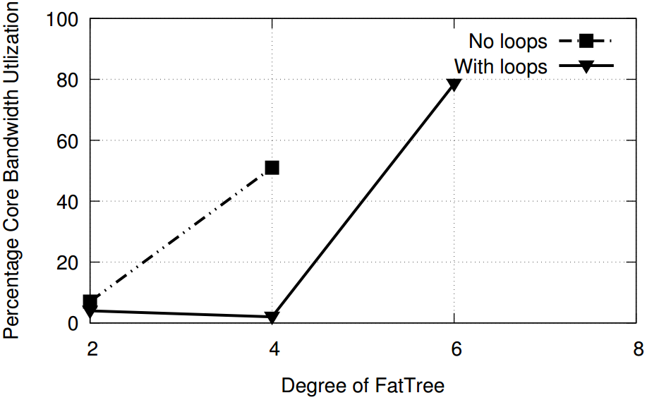
Evaluation- Simulation of Network Mapper
Fat-Tree Topologies

Slide 53
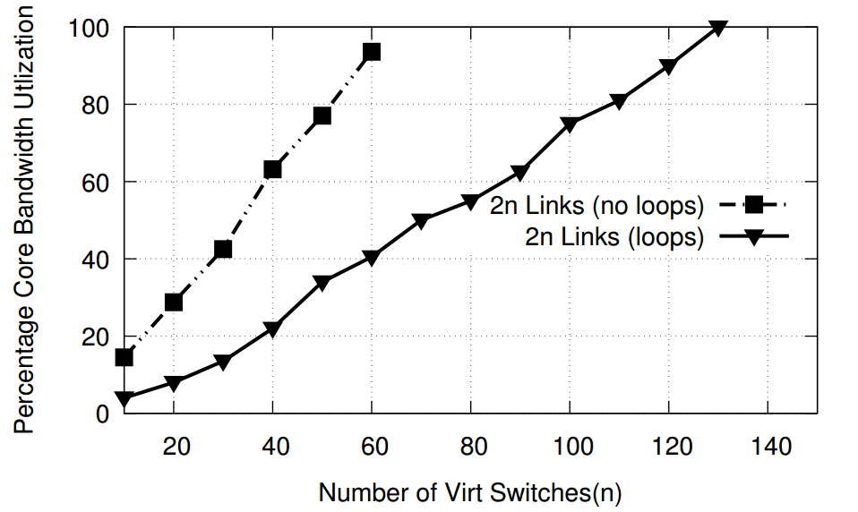
Evaluation- Simulation of Network Mapper
Random Topologies : 2n links
~2 x Gain

Slide 54
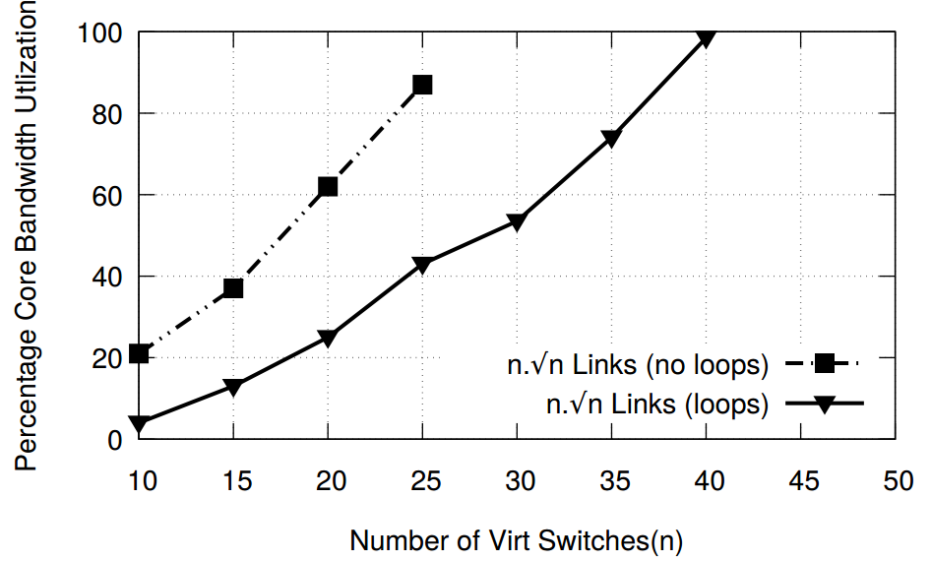
Evaluation- Simulation of Network Mapper
Random Topologies : 2n links

Slide 55
Conclusion
Network Virtualization with hardware (bare-metal) switches :
flexibility of software + fidelity of hardware.
Useful to emulate large DCs, ISPs within cloud.

Slide 56

Thank You

Slide 57
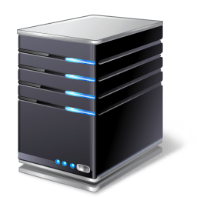
Demo

